Slide 1
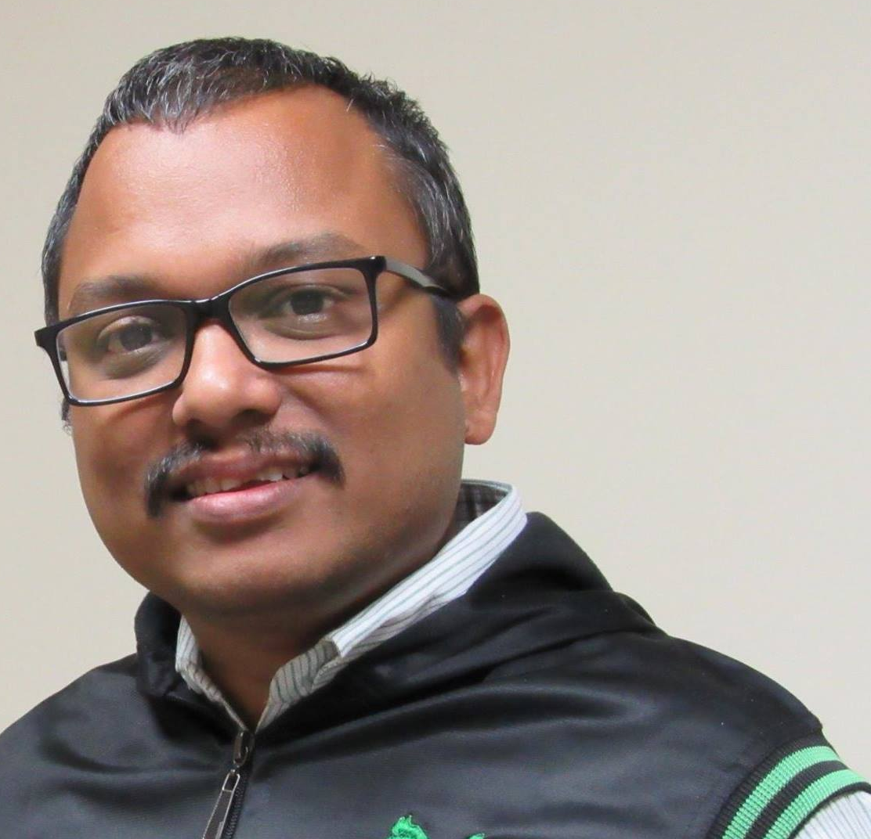
Azure Fundamentals [AZ-900] Part 1
Wriju Ghosh
@wrijugh
6 August 2021 at 1 PM IST

Slide 2
Some important places
All notifications https://groups.google.com/g/techtalks-wriju
YouTube Channel https://www.youtube.com/c/TechTalksWriju
Dev.io Blog - https://dev.to/wrijugh
LinkedIn https://www.linkedin.com/in/wrijughosh
Facebook Page https://www.facebook.com/groups/azureforall

